Slide 1
Daily Scrum 08/17
Summer Camp 2016
Han Sang Lee Department of Computer Science Software Engineering Laboratory (SELAB) Soongsil University hillofsky@naver.com

Slide 2
Task List
Assigned Task | Progress
Data Modeling: Class Diagram | 80%->90%
Database Design | 80%->90%

Slide 3
Yesterday’s Task

Slide 4
Today’s Task
What I did?
Refine Wrap-up Documentation
Data based Class Diagram
DB Design
Implementing ‘Login with Enter’ function

Slide 5
Today’s Task
How I did?
Refine Wrap-up Documentation
Advice from HJ
Following Documentation Style
UserDataManager -> UserProfileManager
add_user_data() -> add_user_profile()
get_uesr_data() -> get_user_profile()
Refactoring code in project
Also, change DB’s table name and attribute names
Implementing ‘Login with Enter’ function
Implementing javascript function – check_login()
Processing submit transmission & authorizing logic for login
Which invoked user press enter key in input tag (password)
In html, if(event.keyCode==13) then invoke check_login()

Slide 6
Today’s Task
Result
Finally… Can login with Enter!!!

Slide 7
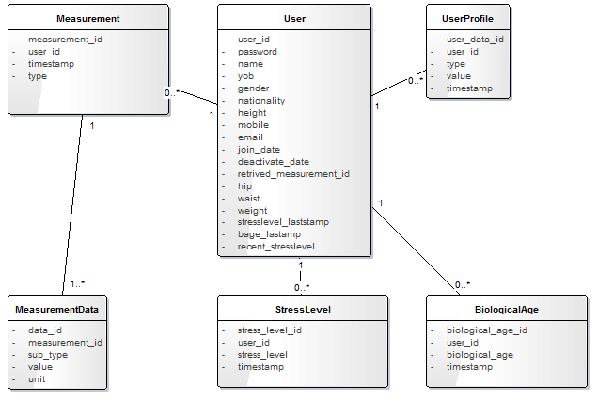
Today’s Task
Result – Class Diagram

Slide 8
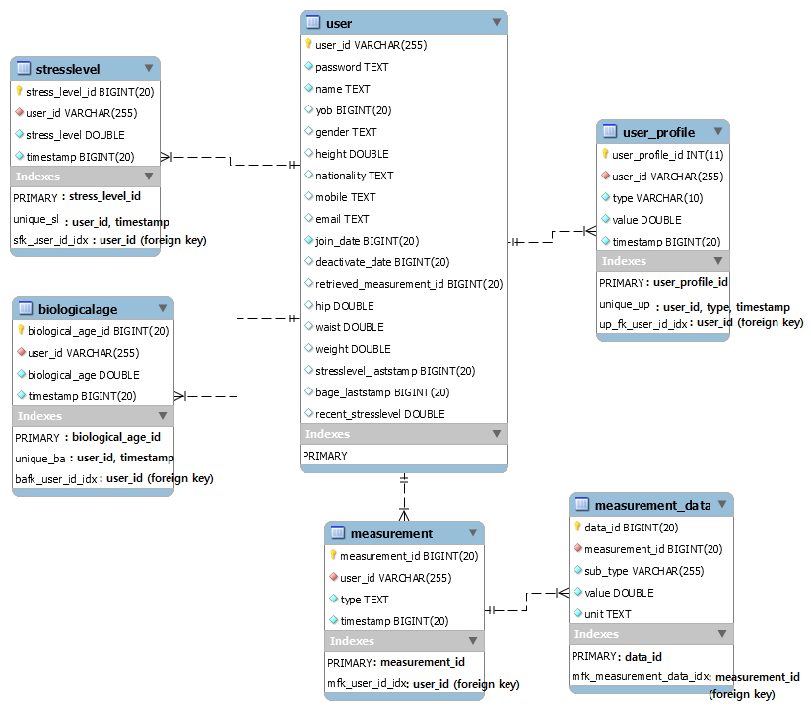
Today’s Task
Result – DB Scheme

Slide 9
Today’s Task

Slide 10
To do
Refining Wrap-up Documentation

Slide 11
Technical Issue (None for today)

Slide 12
Technical Issue
Sometimes did not working in DB
Foreign key : DELETE & UPDATE OPTION : CASCADE
Did not work…
Work after DB reboot

Slide 13
Thank You !

